Slide 1
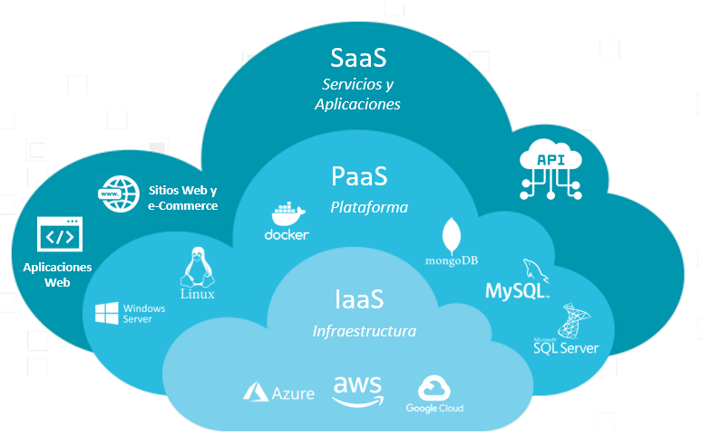
Cloud Service Models by the big three – AWS, Azure and GCP
MADE BY –
NAME: SHANTANU SHUKLA Enrolment No.: 01211805424
Course: M. TECH. (AI &DS)
Institute: C-DAC NOIDA

Slide 2
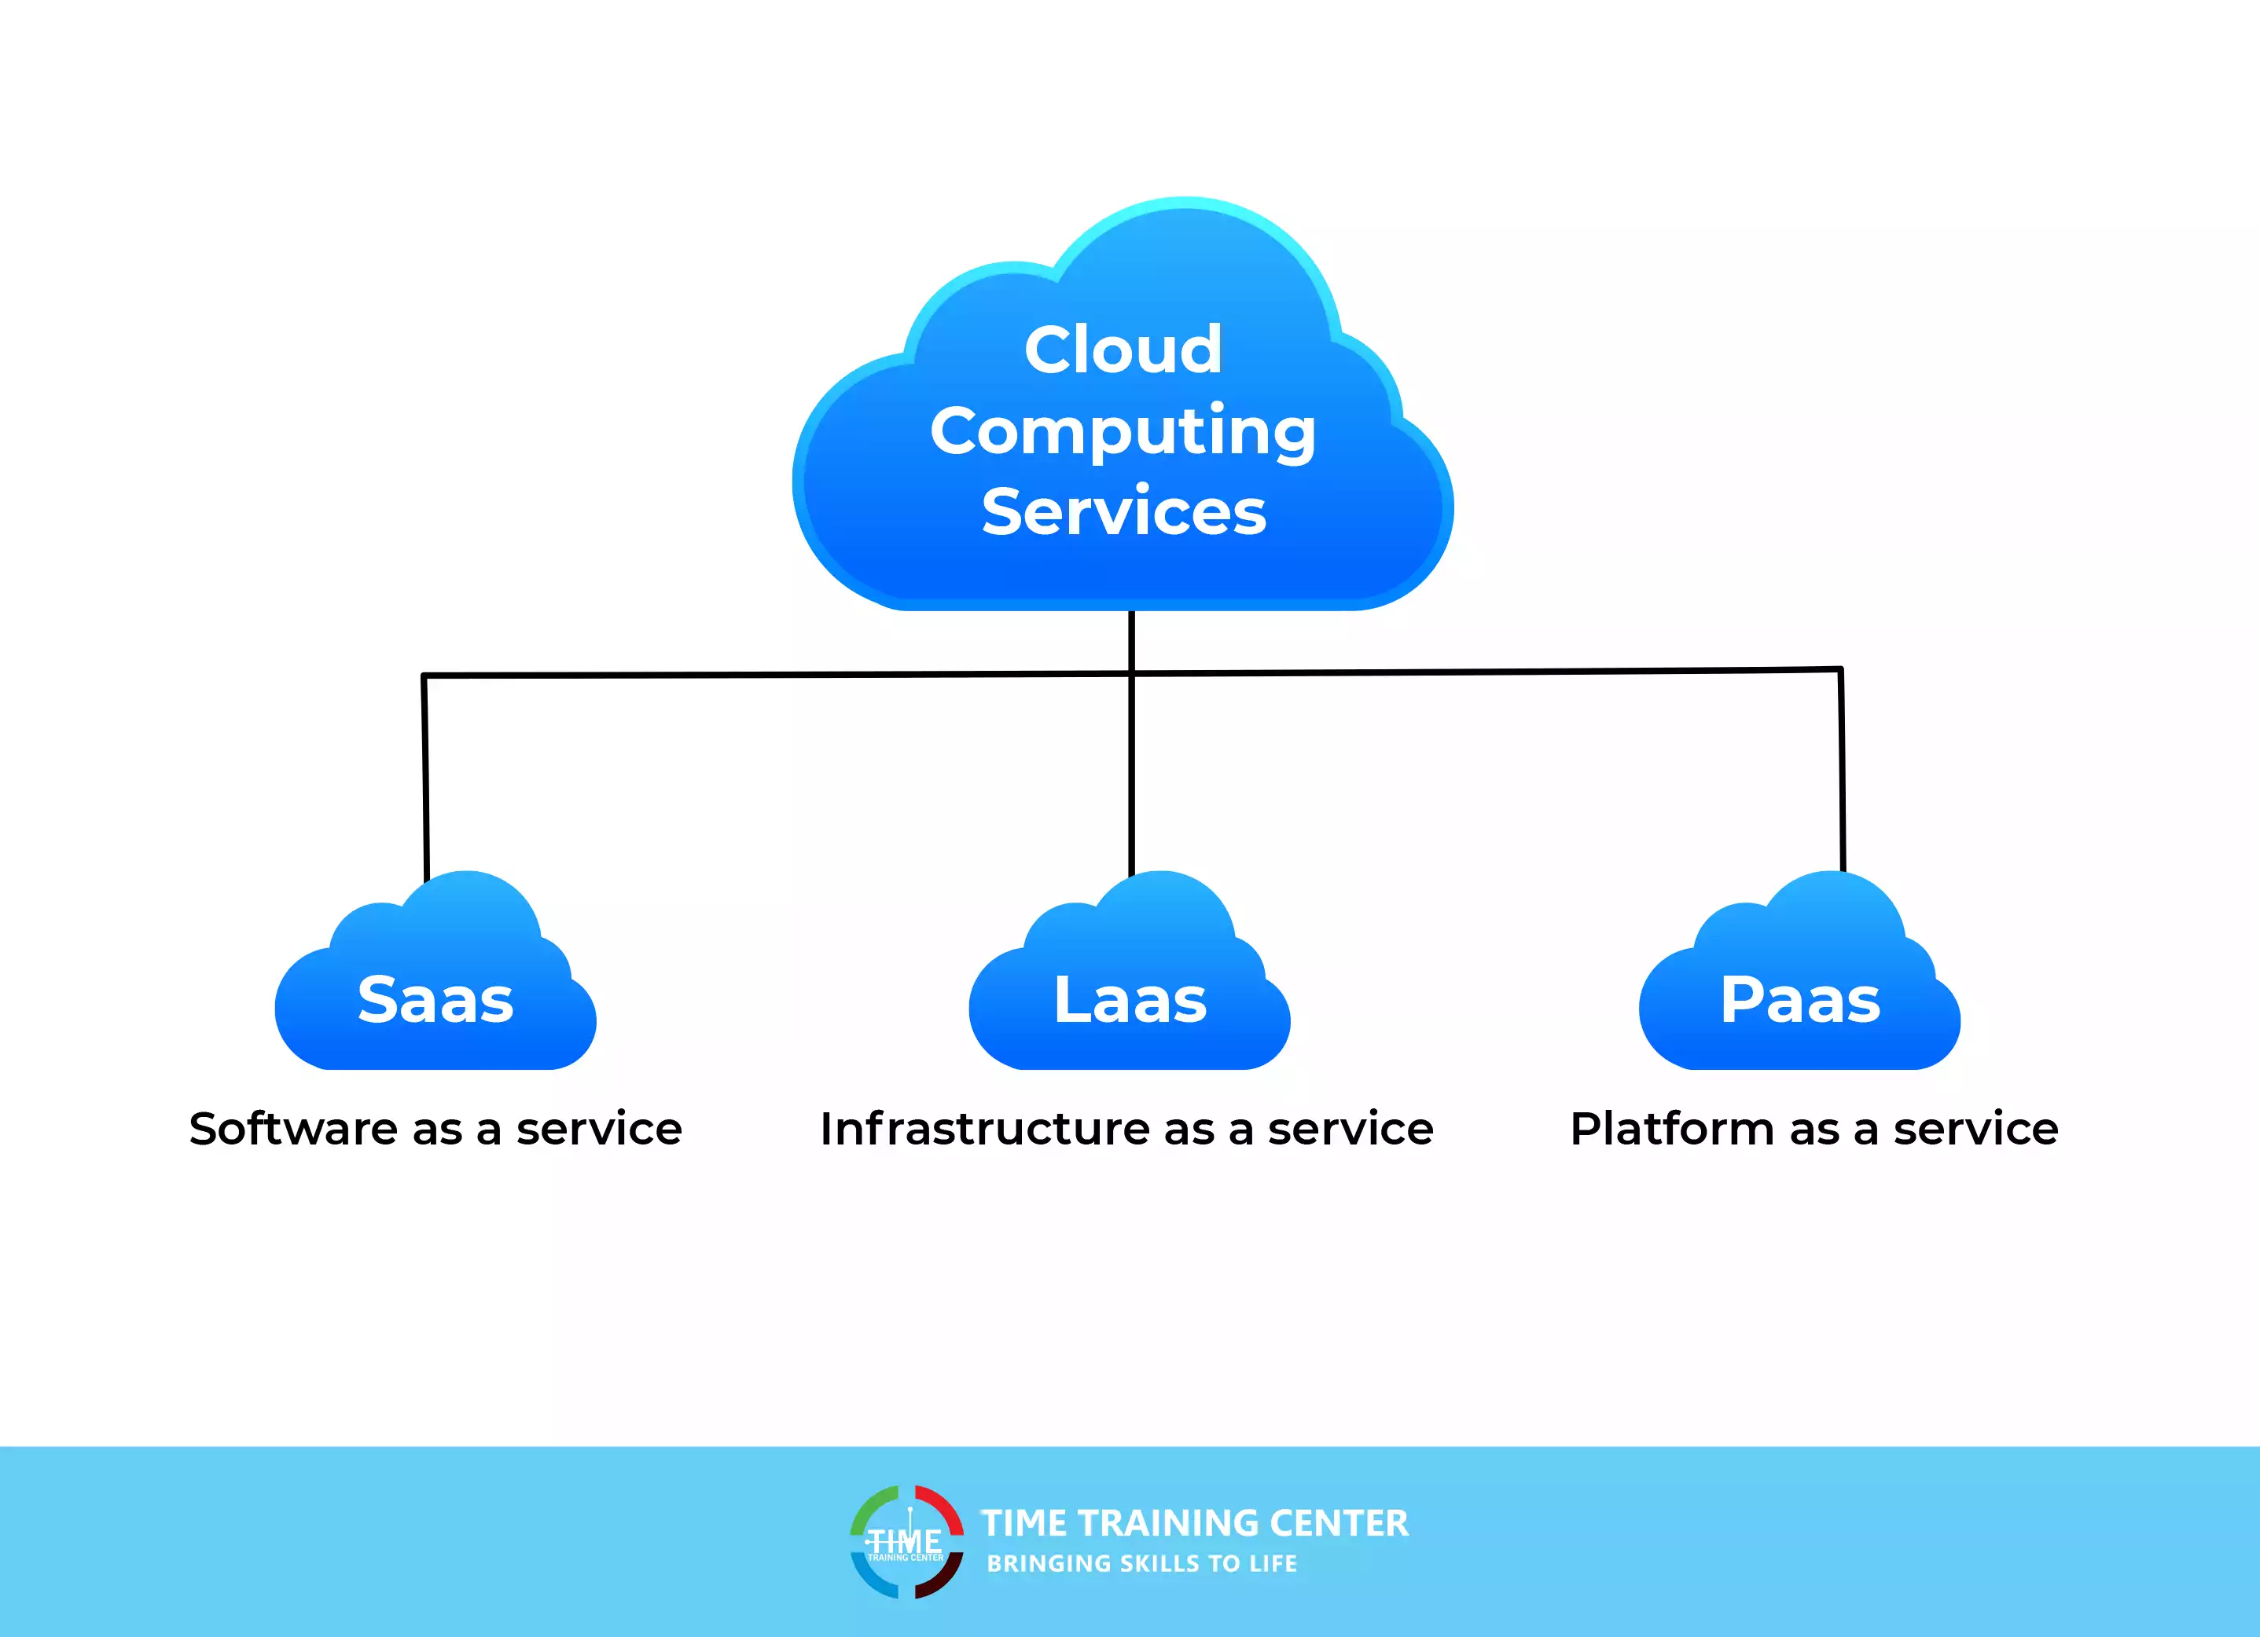
INTRODUCTION
There are three types of Cloud Computing Services being offered – SaaS, IaaS, PaaS.
Many companies offer these services but Amazon’s AWS, Google’s GCP and Microsoft’s Azure are the most popular.
Clients avail these services from Cloud Providers which reduces their CapEx and offers flexibility and scalability on the go.

Slide 3
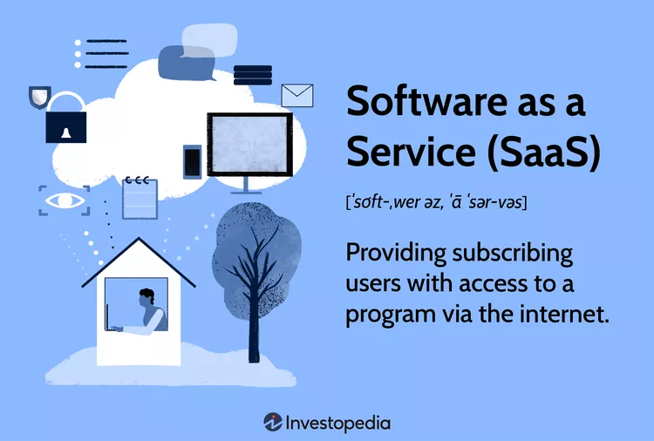
Software as a service - Saas
Software as a service (SaaS) is a software licensing model that allows access to software on a subscription basis using external servers.
SaaS allows each user to access programs via the Internet rather than having to install the software on the user’s computer.
Software as a service has many business applications including file sharing, email, calendars, customer retention management, and human resources.

Slide 4

SAAS offerings BY the big three
Google Cloud Platform (GCP):
Provides SaaS options like Google Workspace (formerly G Suite) for email, documents, and collaboration tools, Google Cloud BigQuery for data warehousing, and AI/ML services like Vertex AI.
Amazon Web Services (AWS):
Offers a wide range of SaaS solutions including Amazon QuickSight for data visualization, Amazon Connect for customer contact centres, and Amazon WorkSpaces for virtual desktops.
Microsoft Azure:
Includes SaaS offerings like Microsoft 365 (including Office applications), Dynamics 365 for CRM, and Azure Active Directory for identity management, leveraging its existing Microsoft product suite.

Slide 5
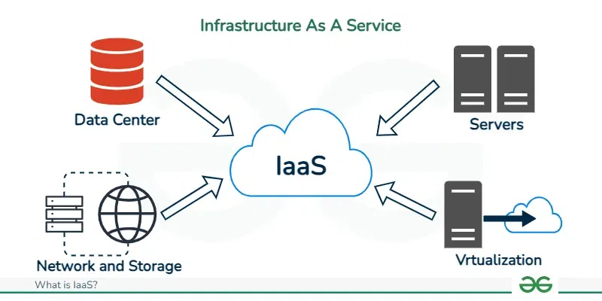
INFRASTRUCTURE AS A SERVICE - IAAS
Infrastructure as a Service (IaaS) is a cloud computing model that gives virtualized computing resources over the web.
with IaaS, associations can get to and manage versatile infrastructure assets like virtual machines, storage, and networking administration parts without the need to put resources into or keep up with actual equipment

Slide 6
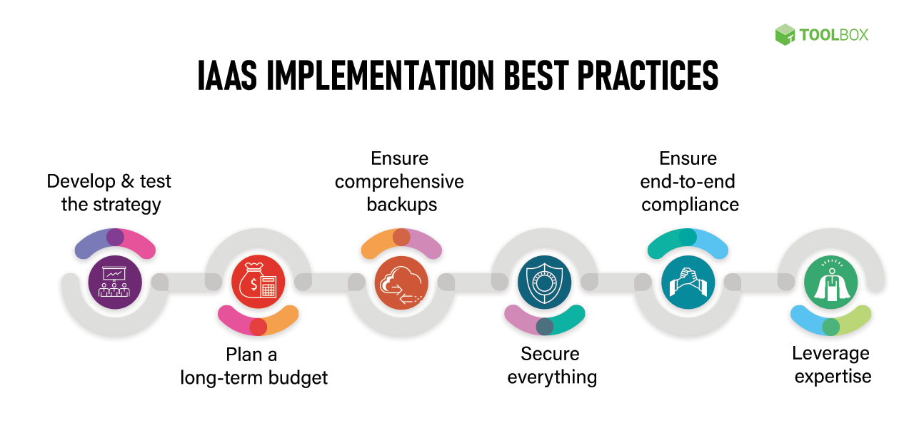
IAAS offerings By the big three
AWS
Amazon S3
Amazon Elastic Block Store
Amazon Elastic File System
Amazon FSx
GCP
Google Cloud Storage
Google Cloud Filestore
Google Persistent Disk
Microsoft Azure
Azure Disk Storage
Azure File Storage
Azure Blob Storage

Slide 7
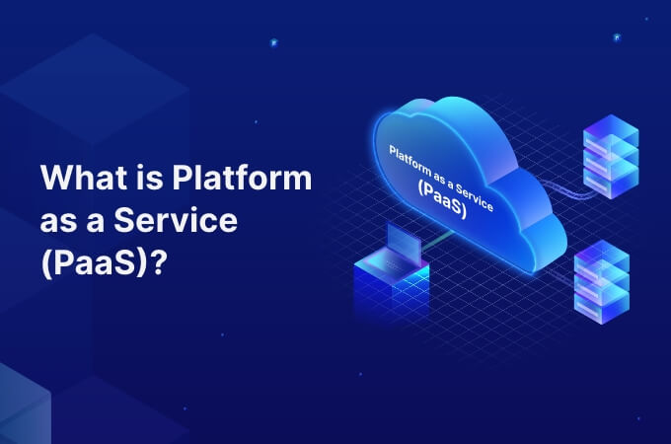
Platform as a service - paas
Platform as a Service (PaaS) is a cloud computing model that provides developers with a ready-to-use platform, including tools, frameworks, and infrastructure, to build, deploy, and manage applications without the burdensome costs, intricacies, and rigidity typically associated with on-premises platform establishment and maintenance.

Slide 8
PAAS offerings By the big three
AWS
AWS Cloud9
AWS CodePipeline
AWS CodeDeploy
AWS Elastic Beanstalk
AWS EKS
GCP
Google App Engine
Microsoft Azure
Azure Web Apps
Azure Web App for Containers
Azure API Apps

Slide 9
CLIENTS THAT USE THEIR SERVICES
AWS
Expedia
Netflix
Coinbase
Formula 1
Coca Cola
GCP
Toyota
Unilever
Nintendo
Spotify
Twitter
Paypal
Microsoft Azure
HSBC
Starbucks
Walgreens
3M
HP
Mitsubishi Electric
Renault

Slide 10
THANK YOU

